Slide 1
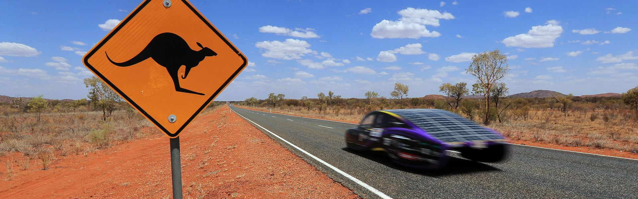

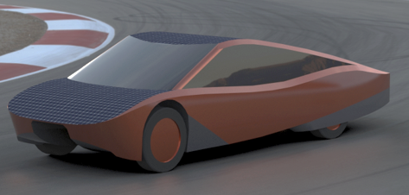
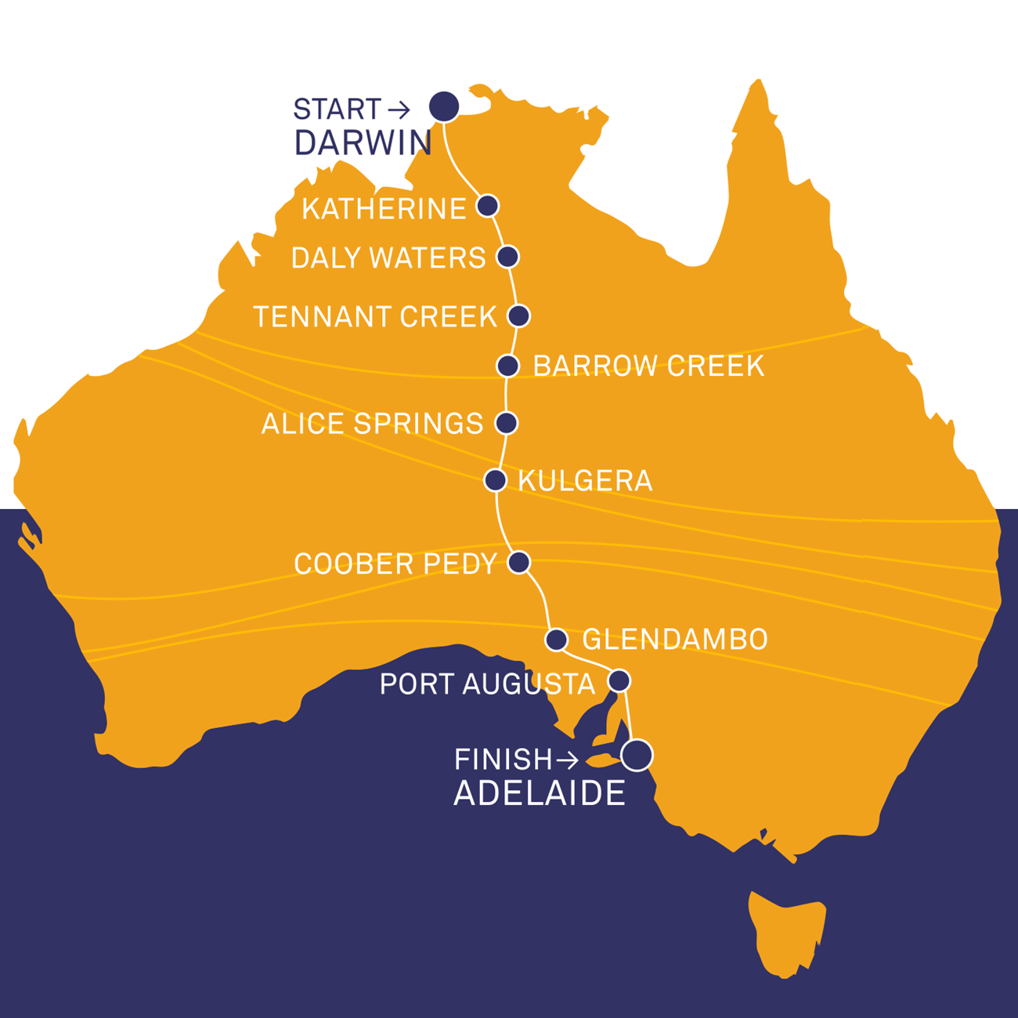
Bridgestone Solar Challenge Info Event
JOIN US IN AUSTRALIA!
Do you want to help build a solar powered car with DTU Roadrunners?
Join us the 15th of June to hear more about the project, which will end with a 3,000 km trip through Australia.
Come meet the team and hear about the exciting projects you can join!
Wednesday 15th June
15.00-19.00
Event Details:
Who? DTU Roadrunners & You
What? Beer, food and project info
Where? B413, R33b (Roadrunner hall)
When? 15th June from 15-19.00
Contact:
Jakob s183391@student.dtu.dk
Ellen s184404@student.dtu.dk

